Slide 1
Employee Data Analysis using Excel
STUDENT NAME: R.ABIRAMI
REGISTER NO: 422200864
DEPARTMENT: III B.COM(INFORMATION SYSTEM MANAGEMENT )
COLLEGES : SHRI KRISHNASWAMY COLLEGE FOR WOMEN ANNA NAGAR

Slide 2
PROJECT TITLE
SALARY AND COMPENSATION ANALYSIS

Slide 3


AGENDA
Problem Statement
Project Overview
End Users
Our Solution and Proposition
Dataset Description
Modelling Approach
Results and Discussion
Conclusion
3/21/2024 Annual Review

Slide 4

PROBLEM STATEMENT
Background Information:
Provide context to understand why the problem is significant.
Problem Description:
Clearly describe the specific issue or issues you are facing.
Impact of the Problem:
Explain the consequences or potential impact of the problem on the organization.
Purpose of the Analysis:
Define what the analysis aims to achieve.
Desired Outcomes:
Specify the outcomes or results you expect from the analysis.

Slide 5

PROJECT OVERVIEW
Project Title:
Salary and Compensation Analysis for [Company Name]
Project Background:
[Company Name] has experienced significant growth and expansion in recent years, leading to an increased workforce and rising compensation costs.
Project Objectives:
The primary objectives of this salary and compensation analysis are to:
Benchmark Compensation:
Compare our compensation packages with industry standards to ensure they are competitive and attractive to potential and current employees.
Scope of Work:
The analysis will cover

Slide 6

WHO ARE THE END USERS?
Project Overview: Salary and Compensation Analysis
1. Project Title: Salary and Compensation Analysis for [Company Name]
2. Project Background: [Company Name] has experienced significant growth and expansion in recent years, leading to an increased workforce and rising compensation costs.
.
3. Project Objectives: The primary objectives of this salary and compensation analysis are to:
Benchmark Compensation: Compare our compensation packages with industry standards to ensure they are competitive and attractive to potential and current employees.
4. Scope of Work: The analysis will cover:
Data Collection: Gathering internal salary and compensation data, including base salaries, bonuses, commissions, overtime, and benefits.
.
5. Methodology: The project will employ the following methodology:
Data Gathering: Collect and organize data from HR systems, compensation records, and external salary surveys.

Slide 7
OUR SOLUATION AND ITS VALUE PROPOSHION
1. Define the Objectives
Objective Setting:
Benchmarking: Compare compensation packages with industry standards.
Equity Analysis: Ensure fair and equitable pay across the organization.
2. Collect and Prepare Data
Data Collection:
Internal Data: Gather information on current salaries, bonuses, commissions, overtime, benefits, and any other compensation elements.
3. Analyze the Data
Benchmarking Analysis:
Comparison: Compare internal compensation with industry benchmarks to evaluate competitiveness.
4. Visualize the Findings
Data Visualization:
Charts and Graphs: Use bar charts, pie charts, and histograms to present salary distributions, compensation components, and benchmark comparisons.

Slide 8

OUR SOLUTION AND ITS VALUE PROPOSITION
1. Define the Objectives
Objective Setting:
Benchmarking: Compare compensation packages with industry standards.
2. Collect and Prepare Data
Data Collection:
Internal Data: Gather information on current salaries, bonuses, commissions, overtime, benefits, and any other compensation elements.
3. Analyze the Data
Benchmarking Analysis:
Comparison: Compare internal compensation with industry benchmarks to evaluate competitiveness.

Slide 9
Dataset Description
1. Value of a Salary and Compensation Solution
1.1. Attracting Talent
Competitive Advantage: A competitive salary and benefits package helps attract top talent in a competitive job market.
2. Solutions for Optimizing Salary and Compensation
2.1. Benchmarking and Market Research
Industry Comparisons: Regularly benchmark salaries and benefits against industry standards to ensure competitiveness.
3. Measuring the Impact and Value
3.1. Key Performance Indicators (KPIs)
Recruitment Metrics: Track time-to-fill, cost-per-hire, and offer acceptance rates to measure the effectiveness of compensation packages in attracting talent.

Slide 10

THE "WOW" IN OUR SOLUTION
1. Competitive Salaries
Benchmarking: Ensuring that salaries are competitive compared to industry standards and peers.
2. Bonuses and Incentives
Performance Bonuses: Rewards tied to individual or team performance.
Profit Sharing: A share of the company's profits distributed to employees.
3. Equity and Stock Options
Stock Options: Offering employees a chance to buy company stock at a set price.
Restricted Stock Units (RSUs): Shares given as part of the compensation package, often with vesting periods.
4. Comprehensive Benefits Package
Health and Wellness: Comprehensive health insurance, dental, vision, and wellness programs.
Retirement Plans: Generous 401(k) matching or pension plans.
3/21/2024 Annual Review

Slide 11
MODELLING
1. Define Objectives
Alignment with Business Goals: Ensure the salary model aligns with the organization’s strategic goals and financial constraints.
Employee Attraction and Retention: Design a model that helps attract and retain top talent.
2. Conduct Market Research
Benchmarking: Research industry salary standards and compensation trends. Tools and resources like salary surveys, industry reports, and compensation databases can be valuable.
3. Establish Salary Structures
Pay Bands: Create salary ranges for different job levels or roles within the organization. These bands should reflect the skills, responsibilities, and market value of each role.
Job Grading: Implement a system to grade jobs based on factors such as complexity, responsibility, and required skills.
4. Incorporate Variables
Base Salary: Set a competitive base salary for each role or pay band.
Bonuses and Incentives: Include performance-related bonuses, profit-sharing, or other incentive programs.

Slide 12
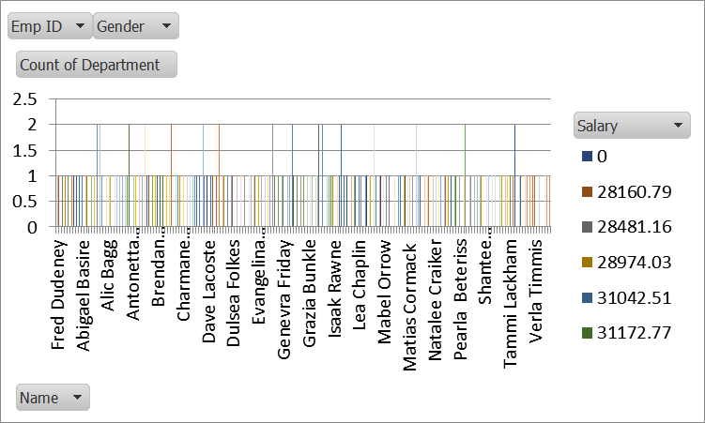
RESULTS

Slide 13
Conclusion Alignment with Objectives: Our salary model is designed to align closely with the organization’s strategic goals, ensuring that compensation supports both talent attraction and retention. By benchmarking against industry standards and incorporating competitive pay bands, we’ve created a structure that reflects the market value of each role while maintaining internal equity

